Slide 1

Gym Client Management System
by Racila, Cristian & Neflas, Florence Keith

Slide 2
Executive Summary - Introduction
Purpose
Functionality
This project simulates a modern gym, handling memberships, billing, and subscriptions for clients.
The system allows employees to manage client accounts, track membership plans.

Slide 3

Project Background
1
1. Motivation
2
2. Objectives
Many gyms still rely on manual processes for client management, leading to inefficiencies and errors.
Develop an automated solution that streamlines gym operations and enhances client satisfaction.
3
3. Target Audience
Gym staff and employees who require a user-friendly system for managing client information, memberships.

Slide 4
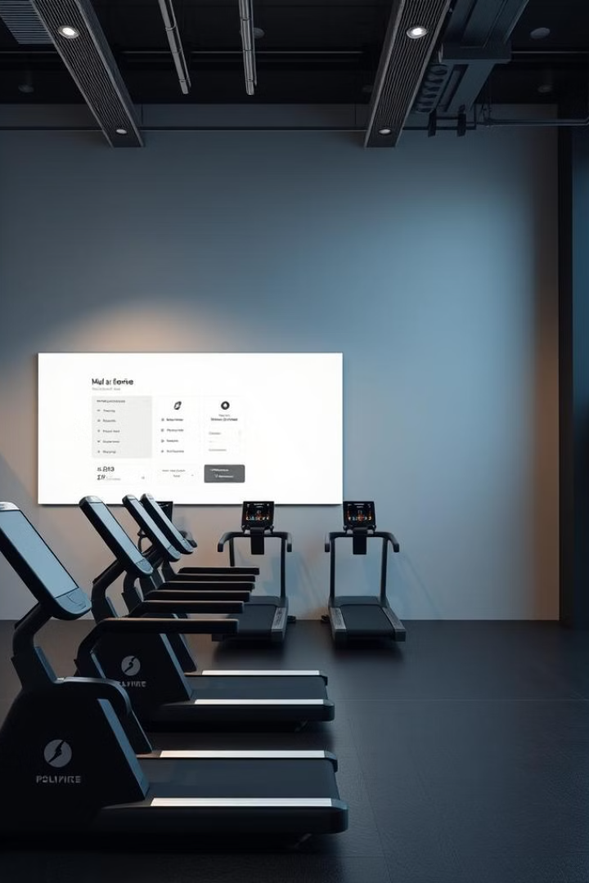
Features and Functionality
Membership Management
Create, delete, ban and edit client, manage membership plans, and track subscription details.

Slide 5



Subscription and Billing
Subscription Plans
Payments (Done over the counter)
Offers two subscription plans (Premium and Regular), each with different terms, fees, and benefits.
Enables clients to make payments over the counter.

Slide 6

Membership Registration and Management
1
Registration
Employees registers clients for membership, providing personal information and selecting a plan.
2
Account Management
Employees can access client profiles, update information, view membership details, and manage payments.

Slide 7



Risks and Anticipations
Data Security
1
Client data is constantly saved to a file to ensure data security.
Blacklist
2
Members of the gym who are known to be malicious could still enter the gym. To fix this, these particular clients will be marked as banned.
Input Validation
3
The user could enter invalid information that can cause errors in long term situations. To fix this, we will implement functions that will verify all user input.

Slide 8
Solutions and Approach
Scalable Database (Future Feature)
1
Use a relational database that can handle large amounts of data and accommodate growth.
User-Friendly Interface
2
Design an user-friendly interface with clear navigation and a helpful user guide.

